Slide 1
CH -8 : Trees and Graphs
Concept of binary tree. Strictly binary tree. Level and depth. Complete and almost complete binary tree. Operations on binary trees. Binary tree traversal.
Concept of binary search tree. Insertion, deletion, and search in binary search tree.
Concept and example of balanced binary tree. Balancing algorithm. Tree applications: expression tree and game tree.
Concept of graph. Types of graph. Graph representations: adjacency matrix representation and linked representation. Depth-first and breadth- first traversal. Concept of spanning and minimum spanning trees. Kruskal’s and Prim’s algorithms for finding minimum spanning tree.
Concept of shortest path. Using Dijkstra’s algorithm for finding shortest path.

Slide 2
Introduction
A tree is a non-linear data structure in which items are arranged in a sorted sequence.
It is used to represent hierarchical relationship existing amongst several data items.
Recursive definition: A tree is defined as a finite set of one or more data items (nodes) such that:
There is a special data item called the root of the tree.
And its remaining data items are partitioned into a number of mutually exclusive (i.e. disjoint) subsets, each of which itself is a tree (called subtrees)
Tree data structure grows downwards from top to bottom.

Slide 3
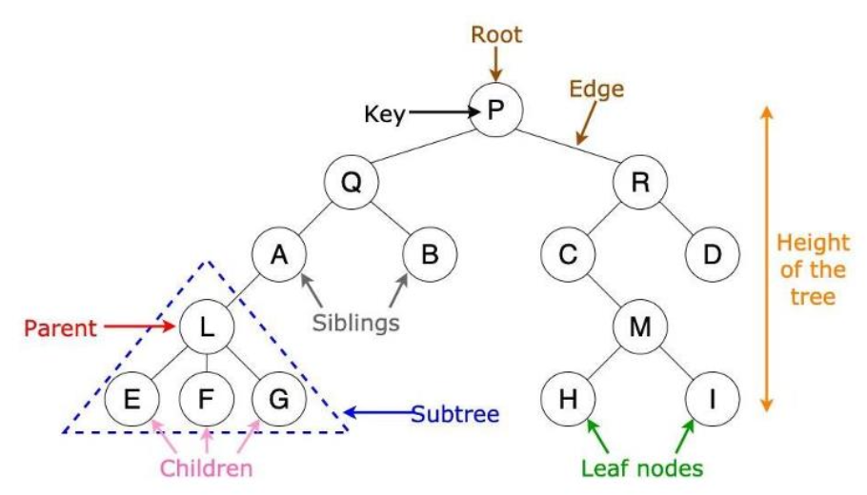
Basic Terminologies

Slide 4
Basic Terminologies[2]
Each data item in a tree is called a node
It is the first data item (or node) in the hierarchical arrangement of data items. In the above tree, P is the root item.
The degree of a node is the number of children of that node
The degree of a tree is the maximum degree of nodes in a given tree
Path is the sequence of consecutive edges from source node to destination node
The height of a node is the max path length from that node to a leaf node
The height of a tree is the height of the root
Depth of a tree is the max level of any leaf in the tree
Level of a node represents the generation of a node. If root node is at level 0, then its next child node is at level 1, its grandchild is at level 2 and so on.

Slide 5
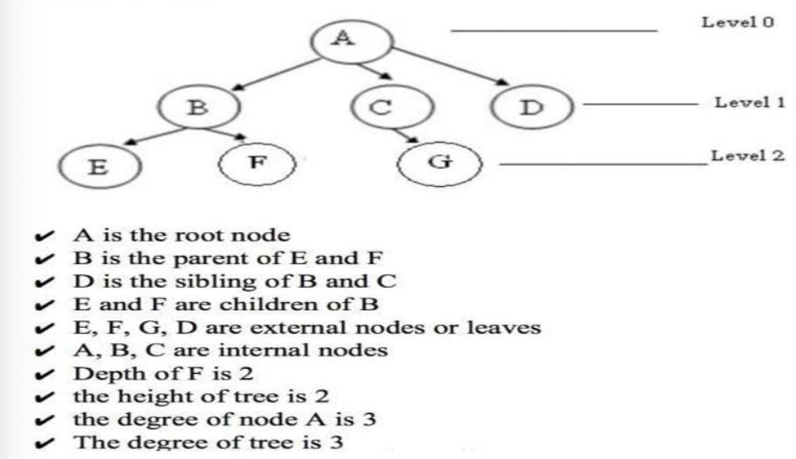
Example

Slide 6
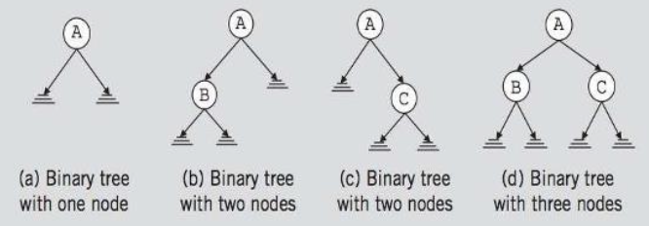
Binary Tree
A binary tree is a finite set of nodes that is either empty or consists of a root and two disjoint binary trees called the left subtree and the right subtree.
Any tree can be transformed into a binary tree by left child-right sibling representation.
The left subtree and right subtree are distinguished.
Examples:

Slide 7
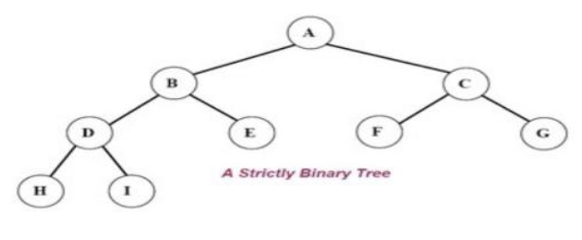
Strictly binary tree
If every non-leaf node in a binary tree has non-empty left and right sub-tree, then such a tree is called a strictly binary tree.
In another words, all of the nodes in a strictly binary tree are of degree zero or two, but never degree one.
A strictly binary tree with N leaves always contain 2N-1 nodes.

Slide 8
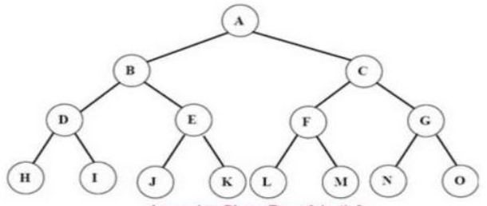
Complete Binary Tree
A complete binary tree is a binary tree in which every level, except possibly the last, is completely filled, and all nodes are as far left as possible.
A complete binary tree of depth d is called strictly binary tree if all of whose leaves are at level d.
A complete binary tree has 2^{d} nodes at every depth d and 2^{d}-1 non leaf nodes.

Slide 9
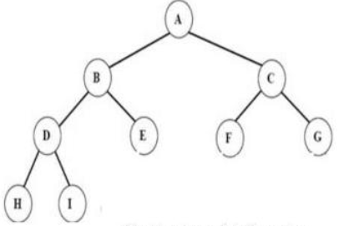
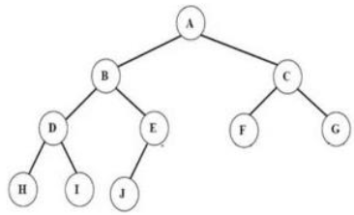
Almost complete binary tree
An almost complete binary tree is a tree where:
For a right child, there is always a left child.
But for a left child there may or may not be a right child.

Slide 10
Binary search tree
A binary search tree is a binary tree that is either empty or in which each node possesses a key that satisfies the following three conditions:
For every node N in the tree, the values of all the keys in its left subtree are smaller than the key value in N.
Keys in its right subtree are greater than the key value in N.
The left and right subtrees of the root are again binary search trees.

Slide 11
Binary search tree {Ex}
=> Create a binary search tree using the following data elements:
43, 10, 79, 90, 12, 54, 11, 9, 50
5, 10, 15, 6, 7, 18, 20, 2

Slide 12
Basic Operation in BST
Insertion
Deletion
Search
Traversal

Slide 13
Basic Operation in BST - Insertion
Insertion a node into an empty tree - the node inserted into the tree is considered as the root node.
Inserting a node into a non-empty tree - we compare the new node to the root node of the tree.
If the value of the new node is less than the value of the root node, then, if the left subtree is empty, the new node is appended as the left leaf of the root node Else, we search continuous down the left subtree.
If the value of the new node is greater than the value of the root node, then, if the right subtree is empty, the new node is appended as the right leaf of the root node Else, we search continuous down the right subtree.
If the value of the new node is equal to the value of the root node, then print “DUPLICATE ENTRY” and return.

Slide 14
Basic Operation in BST - Insertion Algorithm
Insert (TREE, ITEM)
IF TREE == NULL
Allocate memory for TREE
SET TREE->DATA = ITEM
SET TREE->LEFT = TREE->RIGHT = NULL
ELSE
IF ITEM < TREE->DATA
Insert (TREE->LEFT, ITEM)
ELSE
Insert(TREE->RIGHT, ITEM)

Slide 15
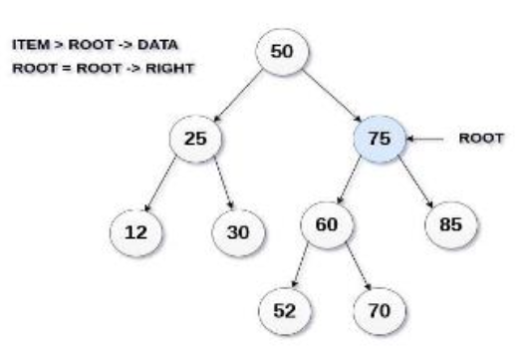
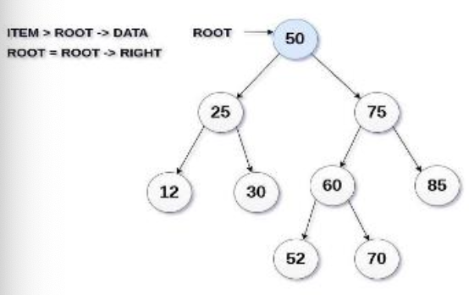
Basic Operation in BST - Insertion [Ex]
Insert (TREE, 95)

Slide 16
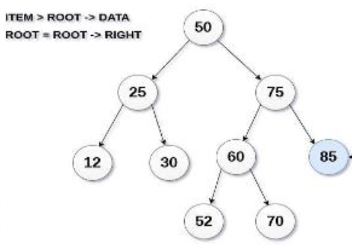
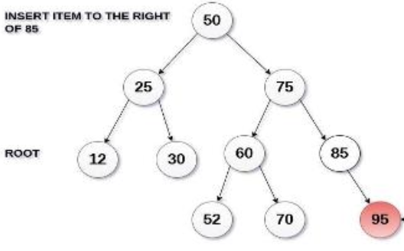
Basic Operation in BST - Insertion [Ex]
Insert (TREE, 95)

Slide 17
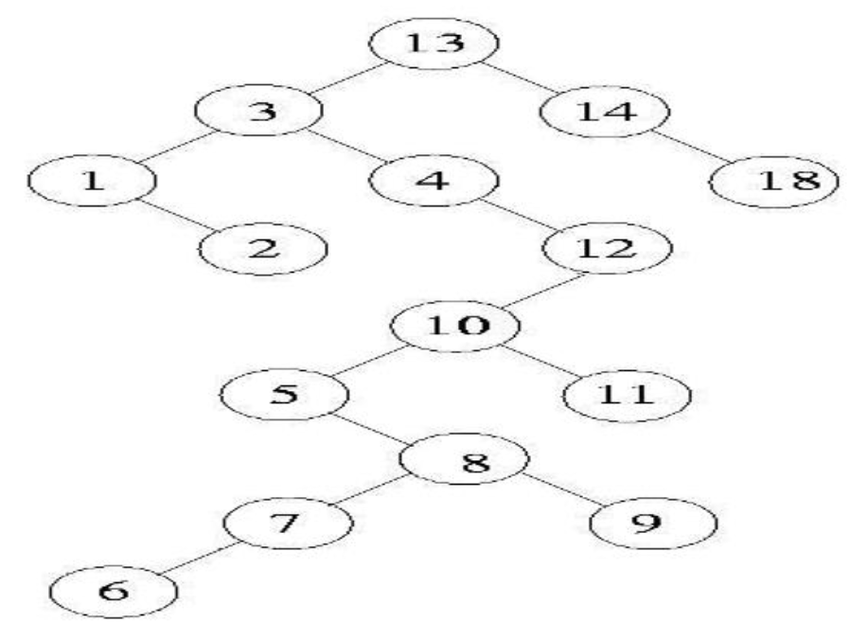
Basic Operation in BST - Insertion [Ex]
Insert items in order from an empty tree to form a BST
{13,3,4,12,14,10,5,1,8,2,7,9,11,18}

Slide 18
Basic Operation in BST - Deletion
Locate the node to be deleted and its parent (The parent of root node is NULL)
If it is the leaf node - set NULL to its parent pointer. If node is with one child -redirect the parent pointer to point to its child pointer.
If node is with two child - replace node being deleted by:
Leftmost node of its right subtree
OR, Rightmost node to its left subtree

Slide 19
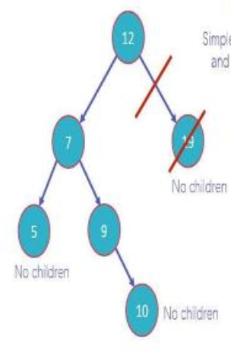
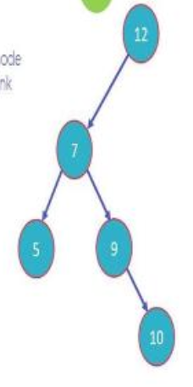
Basic Operation in BST - Deletion [Ex]
Case 1: Node with 0 children: this is the easiest situation, we just need to delete the node which has no further children on the right or left.

Slide 20
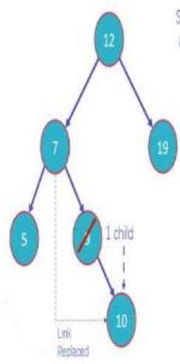
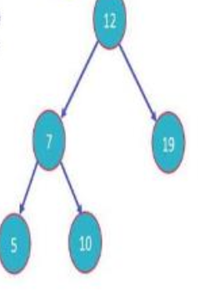
Basic Operation in BST - Deletion [Ex]
Case 2: Node with 1 child: once you delete the node, simply connect its child node with the parent node of the deleted value.

Slide 21
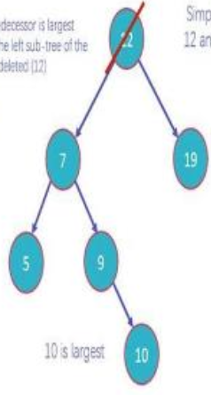
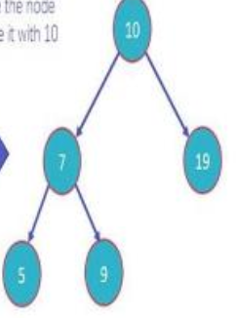
Basic Operation in BST - Deletion [Ex]
Case 3: Node with 2 children: it works on the following two rules:
In order predecessor - we need to delete the node with 2 children and replace it with the largest value on the left subtree of the deleted node.

Slide 22
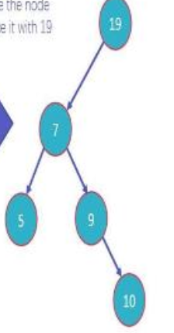
Basic Operation in BST - Deletion [Ex]
Case 3: Node with 2 children: it works on the following two rules:
B. In order successor - we need to delete the node with 2 children and replace it with the smallest value on the right subtree of the deleted node.

Slide 23
Basic Operation in BST - Search
Search operation is performed with O(log n) time complexity in a binary search tree.
This operation starts from the root node.
It is used whenever an element is to be searched.
The following algorithm shows the search operation in binary search tree:
Read the element from the user.
Compare this element with the value of root node in a tree.
If element and value are matching, display "Node is Found" and terminate the function.
If element and value are not matching, check whether an element is smaller or larger than a node value.

Slide 24
Basic Operation in BST - Search[2]
If an element is smaller, continue the search operation in left subtree.
If an element is larger, continue the search operation in right subtree.
Repeat the same process until we found the exact element.
If an element with search value is found, display "Element is found" and terminate the function.
If we reach to a leaf node and the search value is not match to a leaf node, display "Element is not found" and terminate the function.

Slide 25
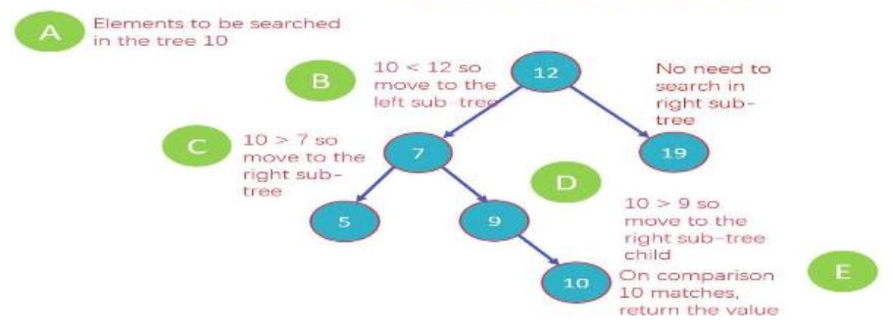
Basic Operation in BST - Search [Ex]
Example - Search for element 10 in the given tree.
Steps:

Slide 26
Basic Operation in BST - Traversal
Binary tree traversing is a process of accessing every node of the tree and exactly once.
A tree is defined in a recursive manner. So, binary tree traversal also is defined recursively.
All nodes are connected via edges, we always start from the root node.
There are three ways which we can use to traverse a tree:
In- order traversal
Pre- order traversal
Post - order traversal
Generally, we traverse a tree to search or locate given item or key in the tree or to print all the values it contains.

Slide 27
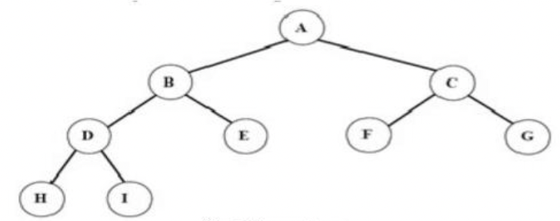
Basic Operation in BST - Preorder Traversal
The preorder traversal is also known as depth first order.
The preorder traversal of a nonempty binary tree is defined as follows:
Visit the root node
Traverse the left sub-tree in preorder
Traverse the right sub-tree in preorder
Order : root=>left=>right
Preorder traversal:
A->B->D->H->I->E->
C->F->G

Slide 28
Basic Operation in BST - Inorder Traversal
The in-order traversal of a non-empty binary tree is defined as:
Traverse the left sub-tree in-order
Visit the root node
Traverse the right sub-tree in in-order
Traversal order=> left->root->right
H->D->I->B->E->A->F-> C->G

Slide 29
Basic Operation in BST - Postorder Traversal
The post-order traversal of a non-empty binary tree is defined as:
Traverse the left sub-tree post-order
Traverse the right sub-tree in post-order
Visit the root node
Traversal order=> left->right->root
H->I->D->E->B->F->G->
C->A

Slide 30
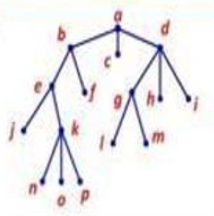
Basic Operation in BST - Traversal [Exercises]
Perform Post order traversal
Perform Preorder traversal
Perform Inorder traversal

Slide 31
Application of Binary Tree
Binary Search Tree - Used in many search applications that constantly show and hide data, such as data. For example, map and set objects in many libraries.
Binary Space Partition - Used in almost any 3D video game to determine which objects need to be rendered.
Binary Tries - Used in almost every high-bandwidth router to store router tables.
Syntax Tree - Constructed by compilers and (implicit) calculators to parse expressions.
Hash Trees - Used in P2P programs and special image signatures that require a hash to be validated, but the entire file is not available.
Heaps - Used to implement efficient priority queues and also used in heap sort.
Treap - Randomized data structure for wireless networks and memory allocation.
T-Tree - Although most databases use a form of B-tree to store data on the drive, databases that store all (most) data often use T-trees.
Huffman Coding Tree (Chip Uni) - Used in compression algorithms, eg. For example, in .jpeg and .mp3.GGM Trees file formats - used in cryptographic applications to generate a tree with pseudo-random numbers.

Slide 32
AVL Tree
AVL Tree is invented by GM Adelson - Velsky and EM Landis in 1962. The tree is named AVL in honour of its inventors.
AVL Tree can be defined as height balanced binary search tree.
Each node is associated with a balance factor which is calculated by Balance Factor = (Height of Left Subtree - Height of Right Subtree)
Tree is said to be balanced if balance factor of each node is in between -1 to 1, otherwise, the tree will be unbalanced and need to be balanced.
We perform rotation in AVL tree only in case if Balance Factor is other than -1,0,and 1.

Slide 33
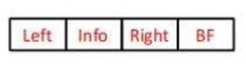
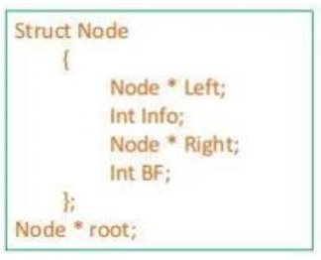
AVL Tree - Representation
AVl Tree can be represented or implemented as other tree in memory with an additional field to keep track of the balance factor.

Slide 34
AVL Tree - Construction
AVL Tree is constructed by using the same process as applied to BST.
The only thing we need to remember that it follow the property of height balance tree.
The balance of each node should be -1,0 or 1.
While operation on AVL - like insertion or deletion is performed, the reee becomes unbalanced and violate the property of AVL tree. So, we need to have to apply different rotation on the AVL Tree.

Slide 35
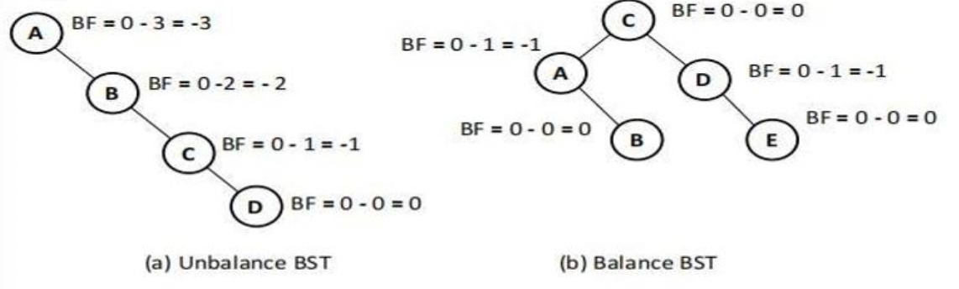
AVL Tree - Construction [Ex]
Note: BF is -1, if the right sub-tree is higher than the left sub-tree [ right heavy] BF is 1, if the left subtree is higher than the right sub-tree[left heavy] BF is 0 ie, Both sub-tree are on same height

Slide 36
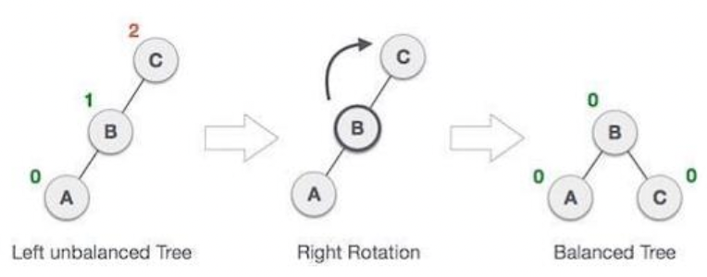
AVL Tree - Rotations
When BST becomes unbalanced, due to node insertion into right subtree, the we perform RR rotation.
RR rotation is an clockwise rotation and applied on the edge below a node having balance factor 2.

Slide 37
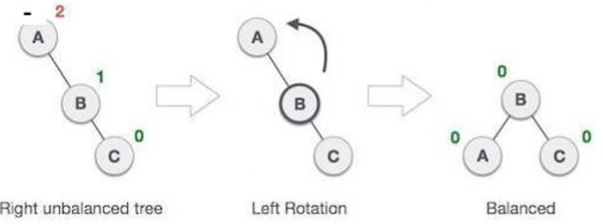
AVL Tree - Rotations
When BST becomes unbalanced, due to node insertion into left subtree, the we perform LL rotation.
LL rotation is an anti-clockwise rotation and applied on the edge below a node having balance factor -2.

Slide 38
AVL Tree - Double Rotations
Double rotations are complicated than single rotation and should be applied carefully.
LR Rotation = LL Rotation + RR Rotation
First LL rotation is performed on subtree
Then RR rotation is performed on full tree,
Full tree means the first node from the path of inserted node whose balance factor is other than -1, 0 or 1.

Slide 39
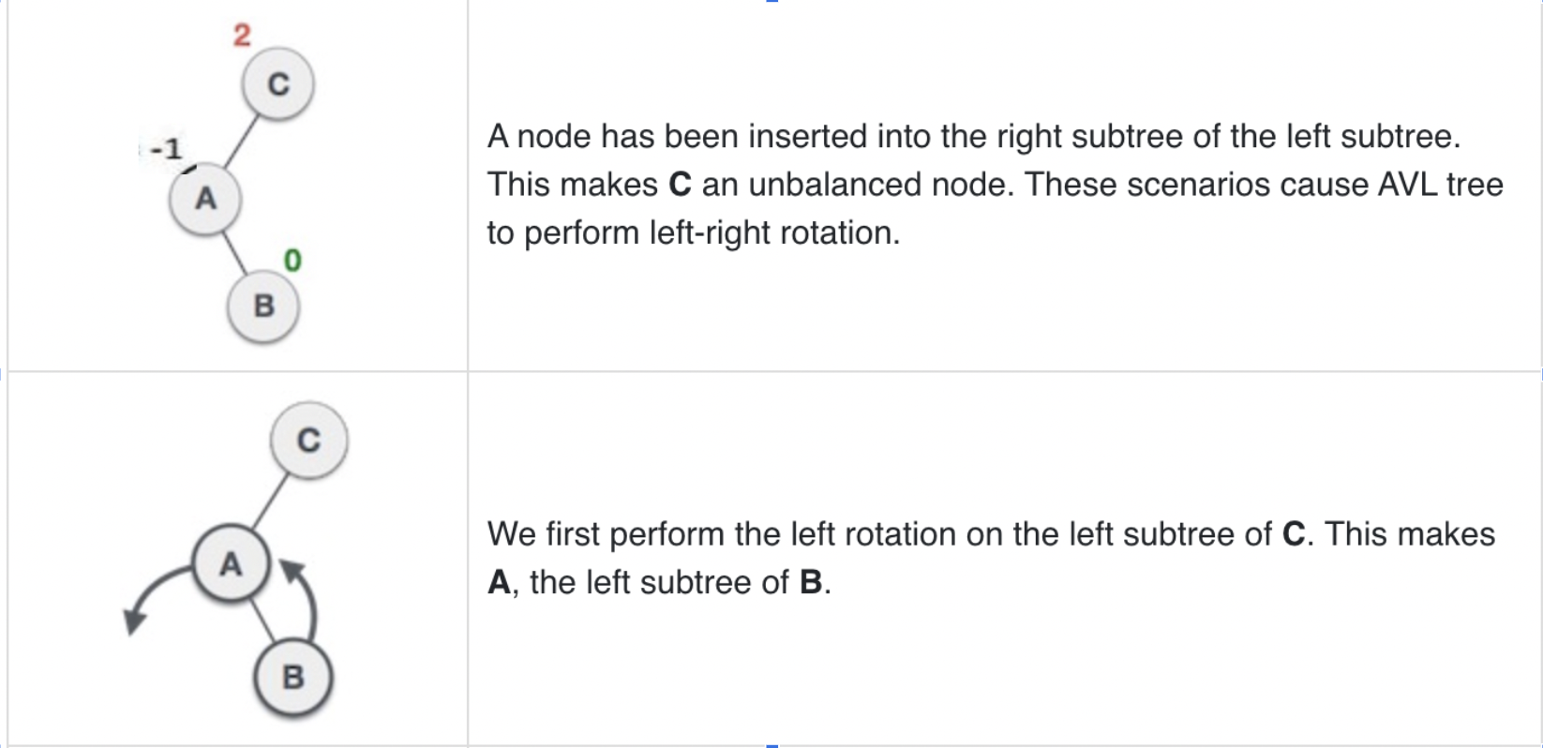
AVL Tree - Double Rotations[2]

Slide 40
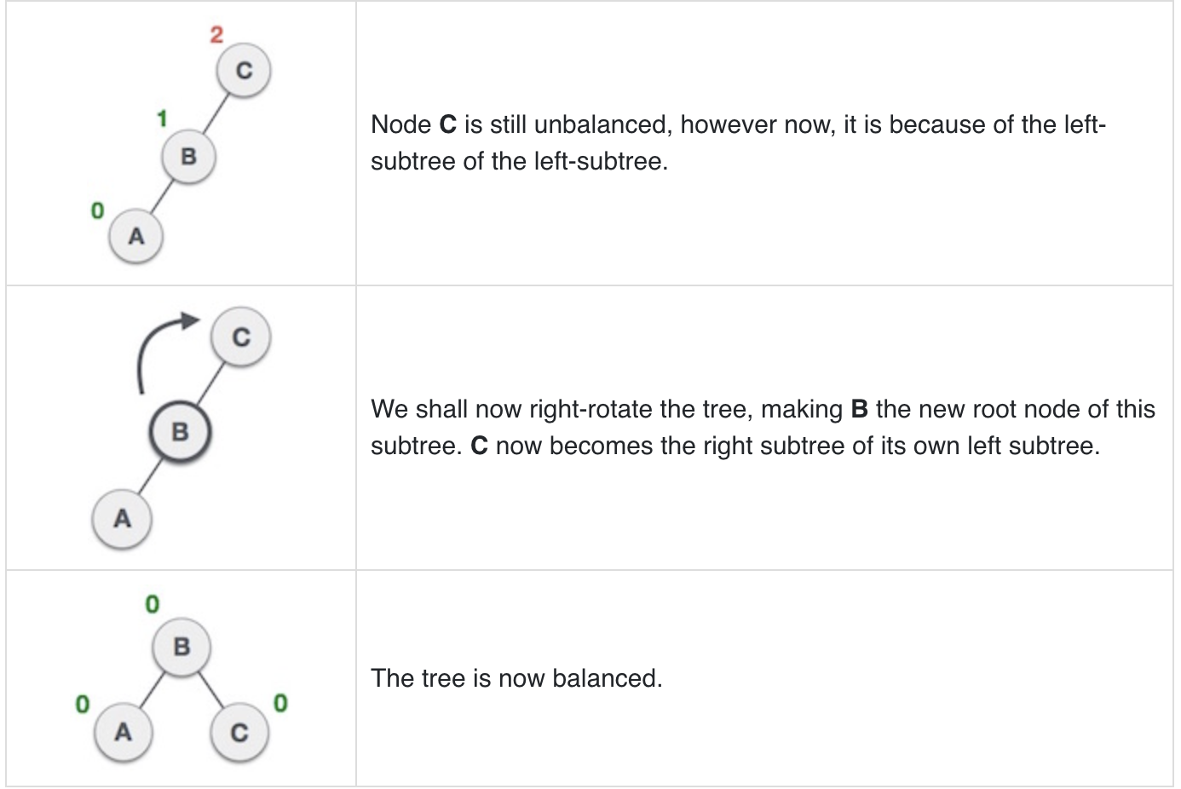
AVL Tree - Double Rotations[3]

Slide 41
AVL Tree - RL Rotation
RL Rotation = RR Rotation + LL Rotation
First RR rotation is performed on subtree
Then LL rotation is performed on full tree,
Full tree means the first node from the path of inserted node whose balance factor is other than -1, 0 or 1.

Slide 42
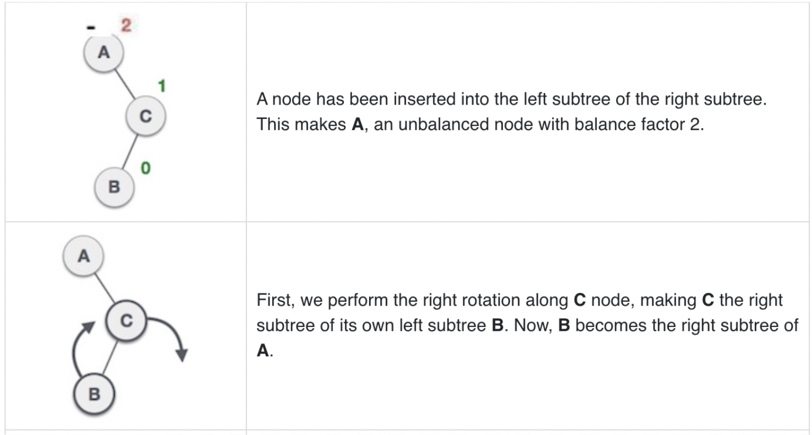
AVL Tree - RL Rotation[2]

Slide 43
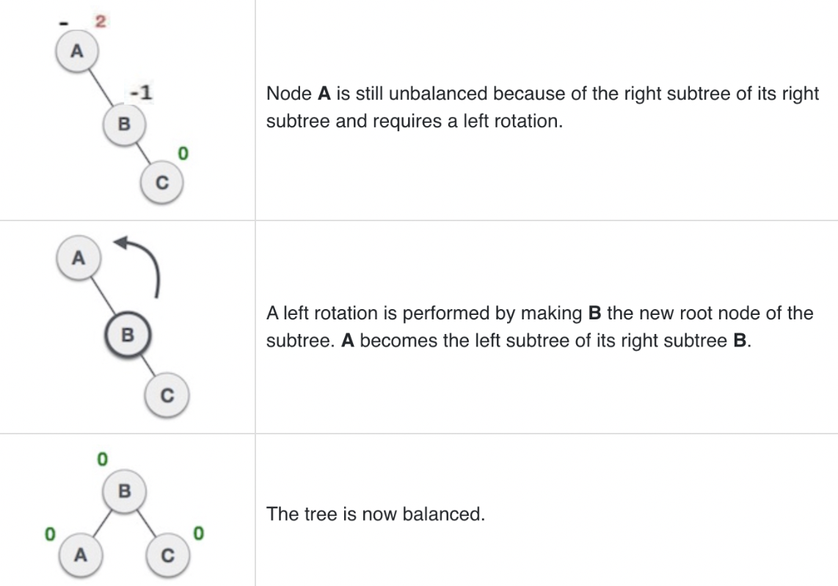
AVL Tree - RL Rotation[3]

Slide 44
Balance Tree - AVL Tree Construction
Insert the new element into the tree using Binary Search Tree insertion logic.
After insertion, check the Balance Factor of every node.
If the Balance Factor of every node is 0, 1 or -1, then go for next operation.
If the balance factor of any node is other than 0,1 or -1 then that tree is said to be imbalanced. In this case, perform suitable Rotation to make it balanced and go for next operation.

Slide 45
Balance Tree - AVL Tree Construction[2]
IF BF(node) = +2 and BF(node->left) = +1, perform RR rotation.
IF BF(node) = -2 and BF(node->right) = -1, perform LL rotation.
IF BF(node) = -2 and BF(node->right) = +1, perform RL rotation.
IF BF(node) = +2 and BF(node->left) = -1, perform LR rotation.

Slide 46
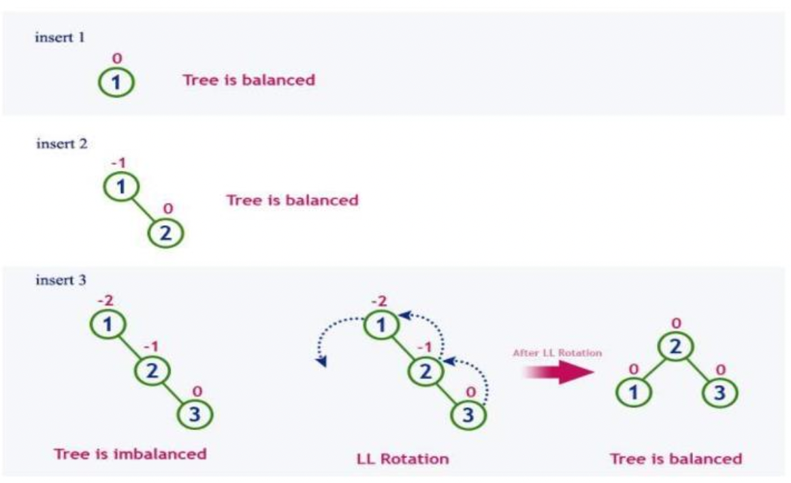
Balance Tree - AVL Tree Construction[3]

Slide 47
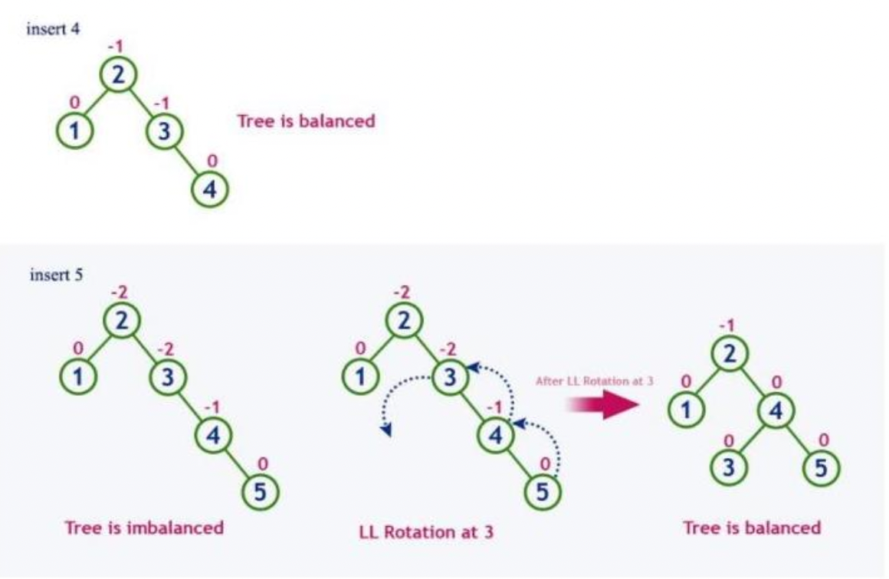
Balance Tree - AVL Tree Construction[4]

Slide 48
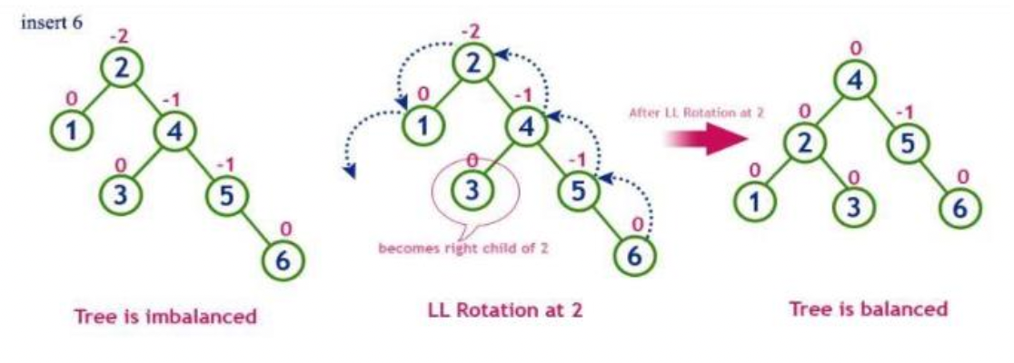
Balance Tree - AVL Tree Construction[5]

Slide 49
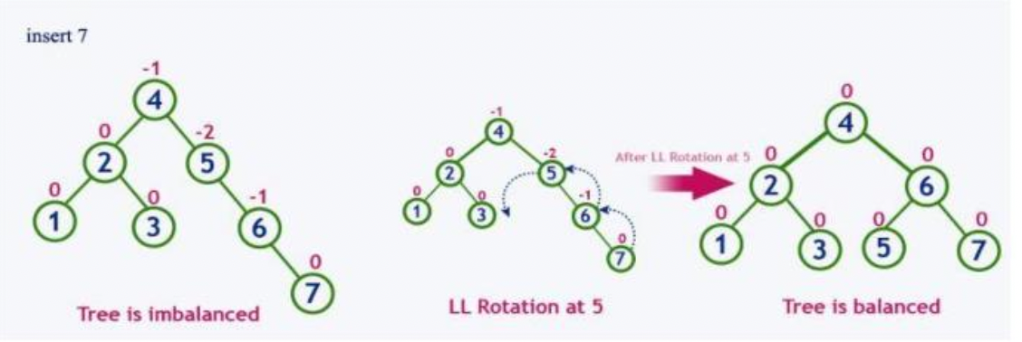
Balance Tree - AVL Tree Construction[6]

Slide 50
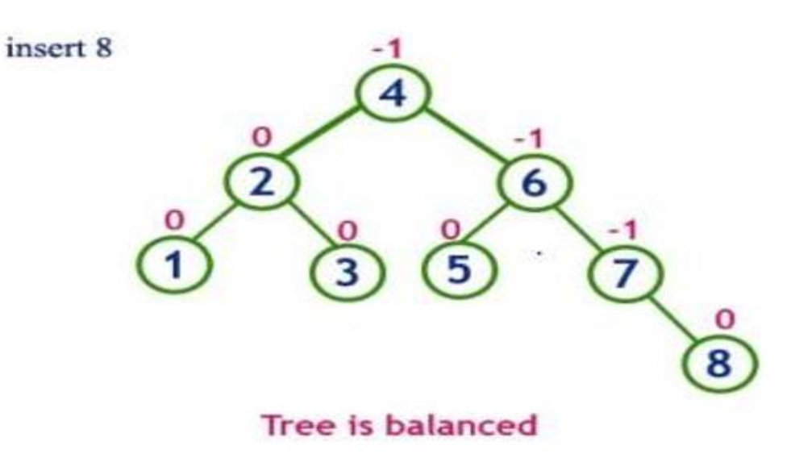
Balance Tree - AVL Tree Construction[7]

Slide 51
B-Tree
B-Tree was developed in the year 1972 by Bayer and McCreight with the name Height Balanced m-way Search Tree.
Later it was named as B-Tree.
B-Tree is a self-balanced search tree in which every node contains multiple keys and can have more than two children.
Here, the number of keys in a node and number of children for a node depends on the order of B-Tree.
Every B-Tree has an order m.
B-Tree of Order m has the following properties:
All leaf nodes must be at same level.
All nodes except root must have at least [m/2]-1 keys and maximum of m-1 keys.
All non leaf nodes except root (i.e. all internal nodes) must have at least m/2 children.
If the root node is a non leaf node, then it must have at least 2 children.
A non leaf node with n-1 keys must have n number of children.
All the key values in a node must be in Ascending Order

Slide 52
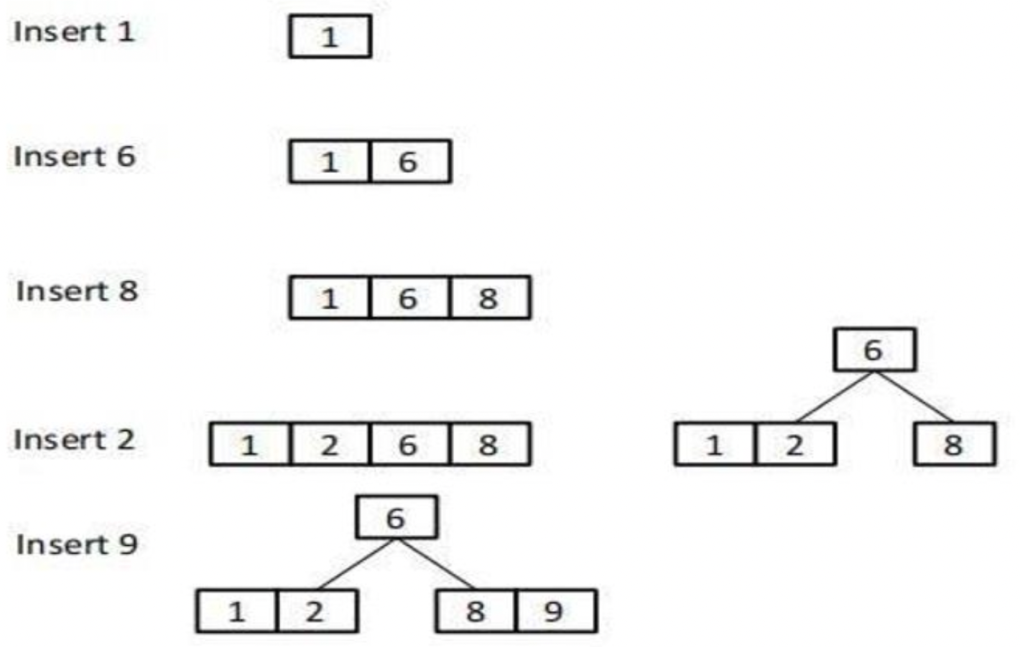
B-Tree[2]
=>Construct a B-Tree of order 4 with the following values: [1,6,8,2,9,12,15,7,18,3,4,20]

Slide 53
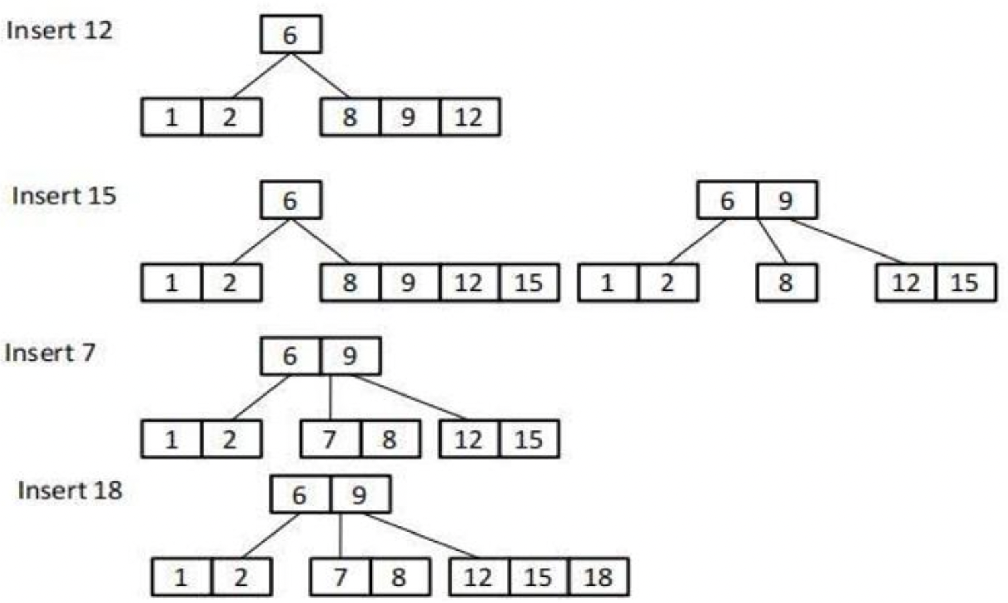
B-Tree[3]
=>Construct a B-Tree of order 4 with the following values: [1,6,8,2,9,12,15,7,18,3,4,20]
Now Add 3,4 & 20 to obtain final B-Tree

Slide 54
Tree Applications
Tree has varieties of applications in the field of computer science and mathematics.
Some most common applications of Tree include:
Expression Tree
Game Tree

Slide 55
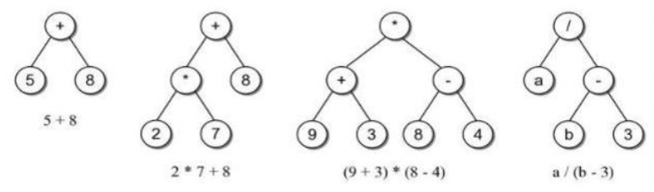
Expression Tree
A binary tree in which the operators are stored in the interior nodes and the operands are stored in the leaves.
Used to evaluate an expression.
Used to convert an infix expression to either prefix or postfix notations.
Expression tree structure is based on the order in which the operators are evaluated.
Operators in lower-level nodes are evaluated first.
The last operator evaluated is in the root node.

Slide 56
Expression Tree[2]
Construct the expression into expression tree:
(A+B)*C-D$(E+F)

Slide 57
Game Tree
Game tree is a graph representing all possible game states within such a game.
Such games include well-known ones such as chess, checkers, Go, and tic-tac-toe.
This can be used to measure the complexity of a game, as it represents all the possible ways a game can pan out.
It is a graph consisting of nodes and edges that represent all the possible legal moves of a (board) game.
The nodes are positions in a game and the edges are the moves.
It is a representation of the play of a game where the root or first node is the initial state of the game, the first level is all the possible moves of the player, and the content of the nodes are the resulting states of the game; the leaf nodes represent when the game is over.

Slide 58
Game Tree[2]
Game trees are used to represent two-player games.
Alternate moves in the game are represented by alternate levels in the tree (plies).
Nodes in the tree represent positions.
Edges between nodes represent moves.
Leaf nodes represent won, lost or drawn positions.
For most games, the game tree can be enormous.

Slide 59
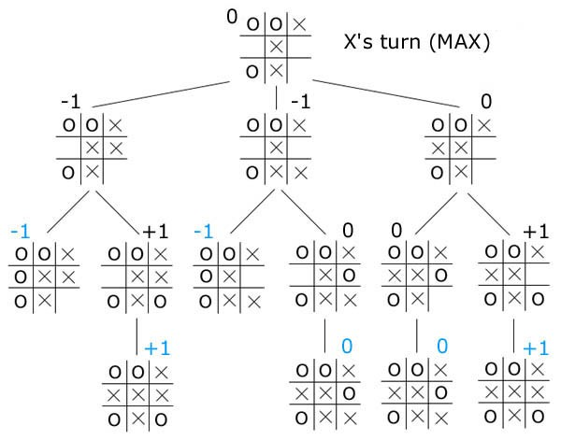
Game Tree[3]
Example:

Slide 60
Huffman Coding
In 1951, David Huffman found the “most efficient method of representing numbers, letters, and other symbols using binary code”. Now standard method used for data compression.
In Huffman Algorithm, a set of nodes assigned with values if fed to the algorithm. Initially 2 nodes are considered and their sum forms their parent node.
When a new element is considered, it can be added to the tree. Its value and the previously calculated sum of the tree are used to form the new node which in turn becomes their parent.
Let us take any four characters and their frequencies, and sort this list by increasing frequency.
Since to represent 4 characters the 2 bit is sufficient thus take initially two bits for each character this is called fixed length character.

Slide 61
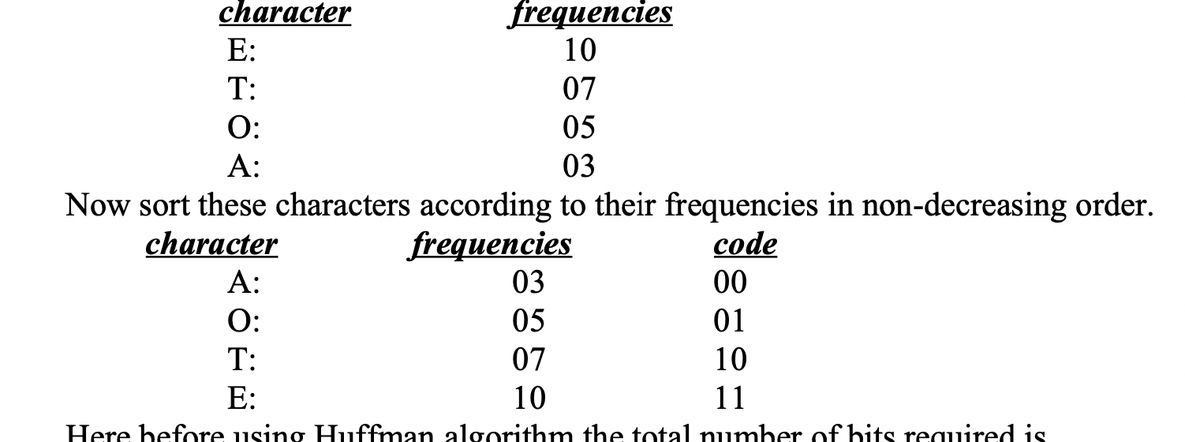
Huffman Coding[2]
Here before using Huffman algorithm the total number of bits required is nb=3*2+5*2+7*2+10*2=06+10+14+20 = 50 bits

Slide 62
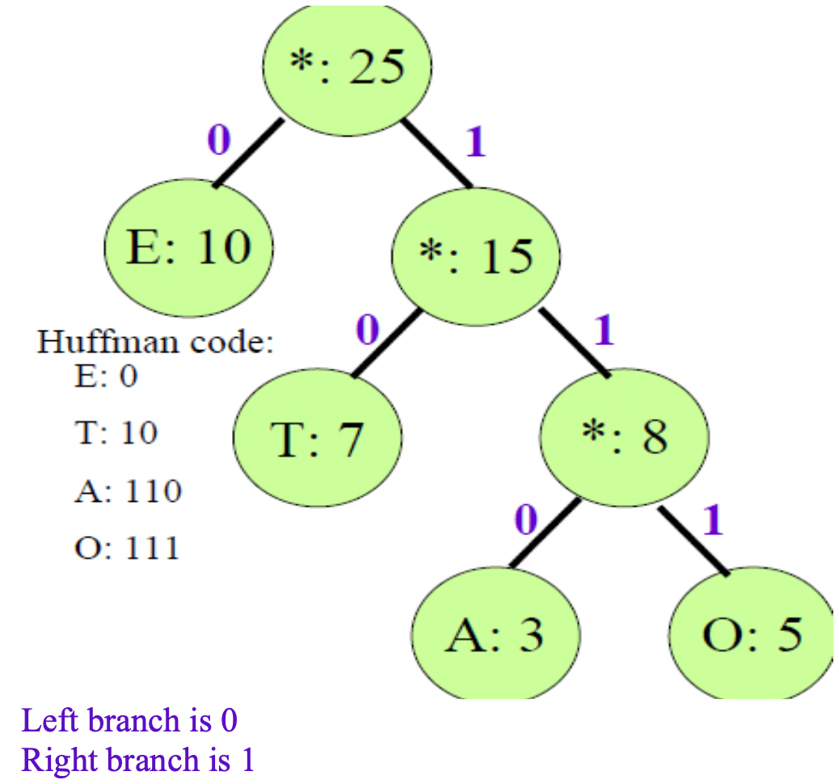
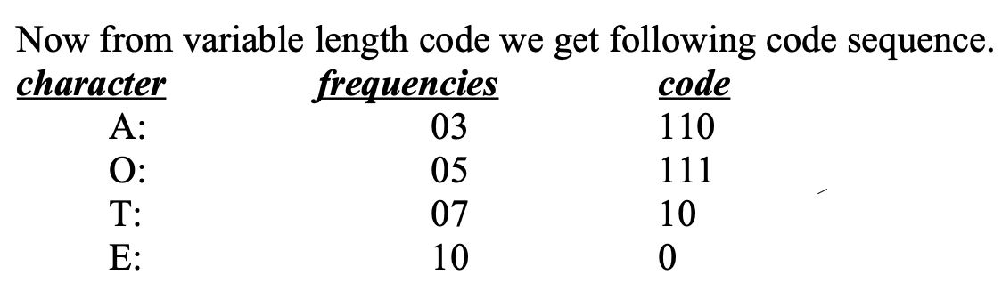
Huffman Coding[3]

Slide 63
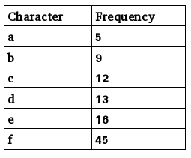
Huffman Coding[4]
Thus after using Huffman algorithm the total number of bits required is nb = 3*3+5*3+7*2+10*1=09+15+14+10=48 bits
Reduction of bits is (50-48)/50 * 100% = 4%
In real life, we have large information with a lot of characters and their frequencies are also significantly large, se we can save a lot of space.
Ex: For the characters with given frequencies, construct the Huffman coding tree and find the number of bits saved by using the Huffman coding.

Slide 64
Graph
A graph is a pictorial representation of a set of objects where some pairs of objects are connected by links.
Graph is a non-linear data structure.
Graph is a data structure that consists of the following two components:
A finite set of vertices called nodes.
A finite set of ordered pair of form (u,v) called as edge indicating that there is a connection from vertex u to vertex v. The pair is ordered because (u,v) is not the same as (v,u) in case of a irected graph(di-graph). The edges may contain weight/cost/value.

Slide 65
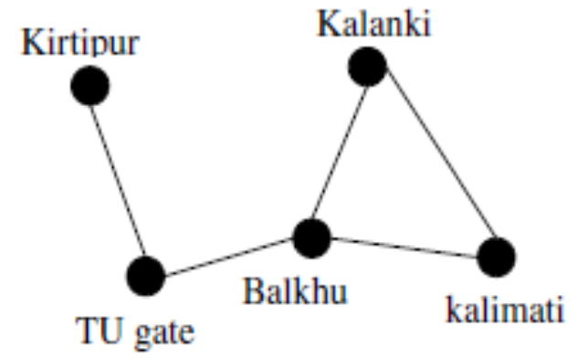
Graph[2]
Mathematically, a Graph is a pair G = (V,E) where V denotes a set of vertices and E denotes the set of edges connecting two vertices.
Many natural problems can be explained using graph for example modeling road network, electronic circuits, etc.
The example below shows the road network.

Slide 66
Graph as an ADT
Graph: a nonempty set of vertices and a set of undirected edges, where each edge is a pair of vertices.
Functions
CreateGraph()=> returns an empty graph
InsertVertex(graph,v)=> returns a graph with v as a vertex inserted.
InsertEdge(graph,v1,v2)=> returns a graph with a new edge between v1 and v2.
DeleteVertex(graph,v)=>returns a graph in which the vertex v and all edges incident to it, are removed.
DeleteEdge(graph,v1,v2)=>returns a graph in which the edge (v1,v2) is removed
isEmpty(graph)=>checks if the graph is empty
Adjacent(graph,v)=>returns a list of all vertices that are adjacent to v

Slide 67
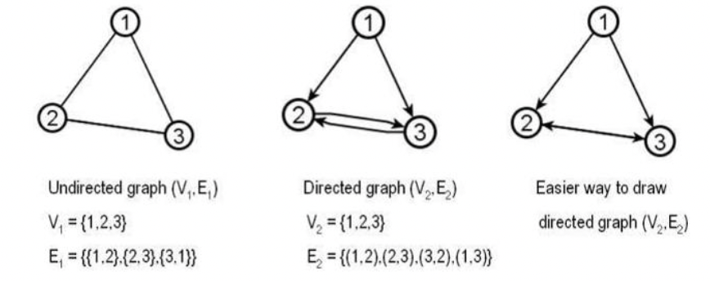
Types of Graph
A graph with only undirected edges is said to be undirected graph.
A graph with only directed edges is said to be directed graph.

Slide 68
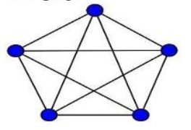
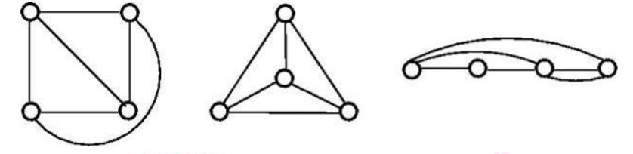
Types of Graph[2]
Complete graph
Planar graph

Slide 69
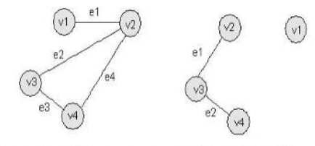
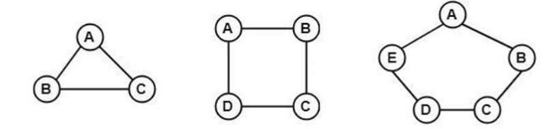
Types of Graph[3]
Connected vs disconnected
Cyclic

Slide 70



Types of Graph[4]
Simple
Multigraph
Pseudograph

Slide 71


Types of Graph[5]
Bipartite graph
Complete bipartite graph

Slide 72

Graph Terminologies
Two vertices u, v are adjacent vertices of a graph if {u, v} is an edge.
The edge e is called incident with the vertices u and v if e = {u, v}.
This edge is also said to connect u and v. where u and v are end points of the edge.
Degree of a vertex in an undirected graph is the number of edges incident with it, except a loop at a vertex. Loop in a vertex counts twice to the degree.
Degree of a vertex v is denoted by deg (v).A vertex of degree zero is called isolated vertex and a vertex with degree one is called pendant vertex.
FIND THE DEGREE OF EACH VERTEX:

Slide 73

GRAPH Representation
Generally graph can be represented in two ways:
adjacency lists(Linked list representation) and
adjacency matrix(matrix).
Adjacency List:
This type of representation is suitable for the undirected graphs without multiple edges, and directed graphs. This representation looks as in the tables below.

Slide 74

GRAPH Representation[2]
If we try to apply the algorithms of graph using the representation of graphs by lists of edges, or adjacency lists it can be tedious and time taking if there are high number of edges.
For the sake of the computation, the graphs with many edges can be represented in other ways. In this class we discuss two ways of representing graphs in form of matrix.

Slide 75

GRAPH Representation[3]
Adjacency Matrix
Given a simple graph G =(V, E) with |V| = n. assume that the vertices of the graph are listed in some arbitrary order like v1, v2, ..., vn. The adjacency matrix A of G, with respect to the order of the vertices is n-by-n zero-one matrix (A = [aij]) with the condition,
Since there are n vertices and we may order vertices in any order there are n! possible order of the vertices. The adjacency matrix depends on the order of the vertices, hence there are n! possible adjacency matrices for a graph with n vertices.

Slide 76


GRAPH Representation[4]

Slide 77


GRAPH Representation[5]

Slide 78
Graph Traversal
Two types:
Breadth-first search:
Depth First search

Slide 79
BFS
Choose some vertex arbitrarily as a root. Add all the vertices and edges that are incident in the root.
The new vertices added will become the vertices at the level 1 of the BFS tree.
Form the set of the added vertices of level 1, find other vertices, such that they are connected by edges at level 1 vertices.
Queue is used
Follow the above step until all the vertices are added.

Slide 80


BFS[1]
Perform BFS on the following graph:
Step1: Choose “a” as an initial vertex.

Slide 81

BFS[2]
Step2:Order the vertices of level 1 ie {b,c,g,e,f}. Say order by {e,f,g,b,c}

Slide 82

BFS[4]
Algorithm:

Slide 83
BFS[5]
Algorithm Analysis:
From the algorithm above all the vertices are put once in the queue and they are accessed.
For each accessed vertex from the queue their adjacent vertices are looked for and this can be done in O(n) time(for the worst case the graph is complete).
This computation for all the possible vertices that may be in the queue i.e. n, produce complexity of an algorithm as O(n2).

Slide 84
Depth First Search (DFS)
This is another technique that can be used to search the graph.
Choose a vertex as a root and form a path by starting at a root vertex by successively adding vertices and edges.
This process is continued until no possible path can be formed.
If the path contains all the vertices, then the tree consisting this path is DFS tree. Otherwise, we must add other edges and vertices.
For this move back from the last vertex that is met in the previous path and find whether it is possible to find new path starting from the vertex just met.
If there is such a path continue the process above.
If this cannot be done, move back to another vertex and repeat the process. This method makes use of stack.
The whole process is continued until all the vertices are met. This method of search is also called backtracking.

Slide 85


Depth First Search (DFS)[2]
Perform DFS on the following graph:
Step 1: Choose a as initial vertex:

Slide 86

Depth First Search (DFS)[3]

Slide 87

Depth First Search (DFS)[4]

Slide 88

Depth First Search (DFS)[5]

Slide 89

Depth First Search (DFS)[6]

Slide 90

Depth First Search (DFS)[7]
Algorithm

Slide 91
Depth First Search (DFS)[8]
Algorithm Analysis
The complexity of the algorithm is greatly affected by Traverse function .
We can write its running time in terms of the relation T(n) = T(n-1) + O(n), here O(n) is for each vertex at most all the vertices are checked (for loop).
At each recursive call, a vertex is decreased.
Solving this we can find that the complexity of an algorithm is O(n²).

Slide 92
Minimum Spanning Trees
A spanning tree of an undirected graph G is a subgraph of G that is a tree containing all the vertices of G.
A minimum spanning tree (MST) for a weighted undirected graph is a spanning tree with minimum weight.
A minimum spanning tree (MST) or minimum weight spanning tree is a subset of the edges of a connected, edge-weighted undirected graph that connects all the vertices together, without any cycles and with the minimum possible total edge weight.
That is, it is a spanning tree whose sum of edge weights is as small as possible.

Slide 93

Minimum Spanning Trees[2]
A minimum spanning tree has (V - 1) edges where V is the number of vertices in the given graph.
An example undirected graph and its minimum spanning tree is as shown below:

Slide 94
Kruskal’s Algorithm
Kruskal's Algorithm builds the spanning tree by adding edges one by one into a growing spanning tree.
Kruskal's algorithm follows greedy approach as in each iteration it finds an edge which has least weight and add it to the growing spanning tree.
Algorithm Steps:
Sort the graph edges with respect to their weights.
Start adding edges to the MST from the edge with the smallest weight until the edge of the largest weight.
Only add edges which doesn't form a cycle , edges which connect only disconnected components.

Slide 95


Kruskal’s Algorithm[2]
Example:
First sort the edges: (1,6)=10; (3,4)=12; (2,7)=14; (2,3)=16; (4,7)=18; (4,5)=22; (5,7)=25; (1,2)=28;
Now pick all edges one by one from the sorted list in increasing order.

Slide 96

Kruskal’s Algorithm[3]
Example:
First sort the edges: (1,6)=10; (3,4)=12; (2,7)=14; (2,3)=16; (4,7)=18; (4,5)=22; (5,7)=25; (1,2)=28;
Now pick all edges one by one from the sorted list in increasing order.

Slide 97

Kruskal’s Algorithm[4]
=>
Since all the vertices have been connected / included in the MST, so we stop. The weight of the MST = sum of the weight of all edges
= 10+25+22+12+16+14 = 99 units.

Slide 98


Kruskal’s Algorithm[2]
Example 2:
=>

Slide 99
Prim’s Algorithm
Prim's Algorithm also use Greedy approach to find the minimum spanning tree.
In Prim's Algorithm, we grow the spanning tree from a starting position.
Unlike an edge in Kruskal's, we add vertex to the growing spanning tree in Prim's.
Algorithm Steps:
Maintain two disjoint sets of vertices. One containing vertices that are in the growing spanning tree and other that are not in the growing spanning tree.
Select the cheapest vertex that is connected to the growing spanning tree and is not in the growing spanning tree and add it into the growing spanning tree. This can be done using Priority Queues.
Insert the vertices, that are connected to growing spanning tree, into the Priority Queue.
Check for cycles. To do that, mark the nodes which have been already selected and insert only those nodes in the Priority Queue that are not marked.

Slide 100
Prim’s Algorithm[2]
In Prim's Algorithm, we will start with an arbitrary node (it doesn't matter which one) and mark it.
At each iteration, we will mark a new vertex that is adjacent to the one that we have already marked.
As a greedy algorithm, Prim's algorithm will select the cheapest edge and mark the vertex.

Slide 101

Prim’s Algorithm[3]
We will simply choose the edge with weight 1.
In the next iteration we have three options, edges with weight 2. 3 and 4. So, we will select the edge with weight 2 and mark the vertex.
Now again we have three options, edges with weight 3, 4 and 5. But we can't choose edge with weight 3 as it is creating a cycle. So we will select the cdgc with weight 4.
And we end up with the minimum spanning tree of total cost 7 ( = 1 + 2 +4).

Slide 102


Prim’s Algorithm[4]
Example 2:
=>

Slide 103
Shortest Path Problem
In graph theory, the shortest path problem is the problem of finding a path between two vertices (or nodes) in a graph such that the sum of the weights of its constituent edges is minimized.
The problem of finding the shortest path between two intersections on a road map may be modeled as a special case of the shortest path problem in graphs,
where the vertices correspond to intersections and
the edges correspond to road segments, each weighted by the length of the segment.

Slide 104
Dijkstra’s Algorithm
It is a greedy algorithm that solves the single-source shortest path problem for a directed graph G = (V, E) with non-negative edge weights, i.e., w (u, v) >= 0 for each edge (u, v) ∈ E.
Dijkstra's Algorithm maintains a set S of vertices whose final shortest - path weights from the source s have already been determined. That is; for all vertices v ∈ S; we have d [v] = ∂ (s, v).
The algorithm repeatedly selects the vertex u ∈ (V-S) with the minimum shortest - path estimate, insert u into S and relaxes all edges leaving u.
Because it always chooses the "lightest" or "closest" vertex in V - S to insert into set S, it is called as the greedy strategy.

Slide 105
Dijkstra’s Algorithm[2]
Algorithmic steps:
The very first step is to mark all nodes as unvisited,
Mark the picked starting node with a current distance of 0 and the rest nodes with infinity,
Now, fix the starting node as the current node,
For the current node, analyse all of its unvisited neighbours and measure their distances by adding the current distance of the current node to the weight of the edge that connects the neighbour node and current node,

Slide 106
Dijkstra’s Algorithm[3]
Algorithmic steps:
Compare the recently measured distance with the current distance assigned to the neighbouring node and make it as the new current distance of the neighbouring node,
After that, consider all of the unvisited neighbours of the current node, mark the current node as visited,
If the destination node has been marked visited then stop, an algorithm has ended, and
Else, choose the unvisited node that is marked with the least distance, fix it as the new current node, and repeat the process again from step 4.

Slide 107

Dijkstra’s Algorithm[4]

Slide 108

Dijkstra’s Algorithm[5]

